Slide 1
Delta Intelligent Smart Screw System
Version 25.07
DET-AMBU

Slide 2
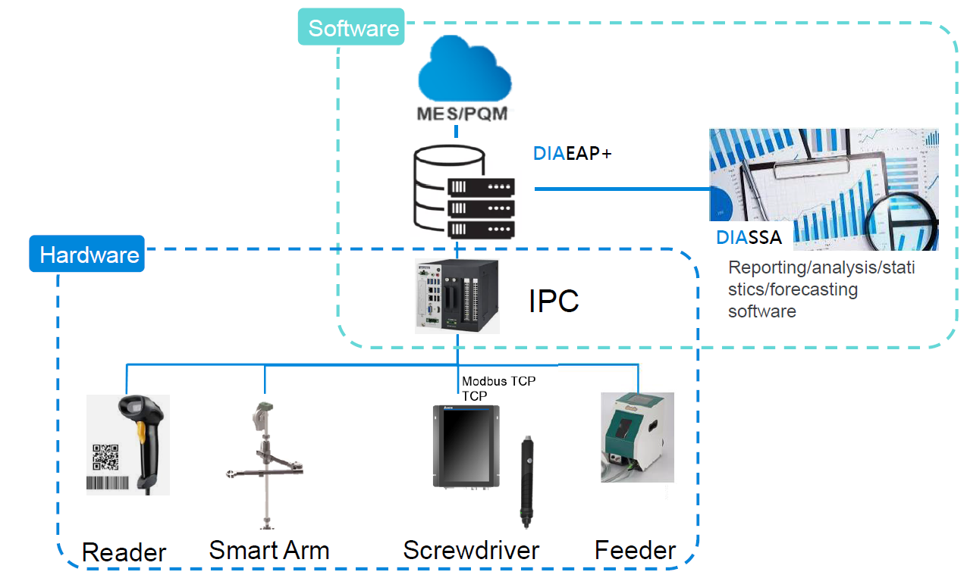
Smart screw system Architecture

Slide 3
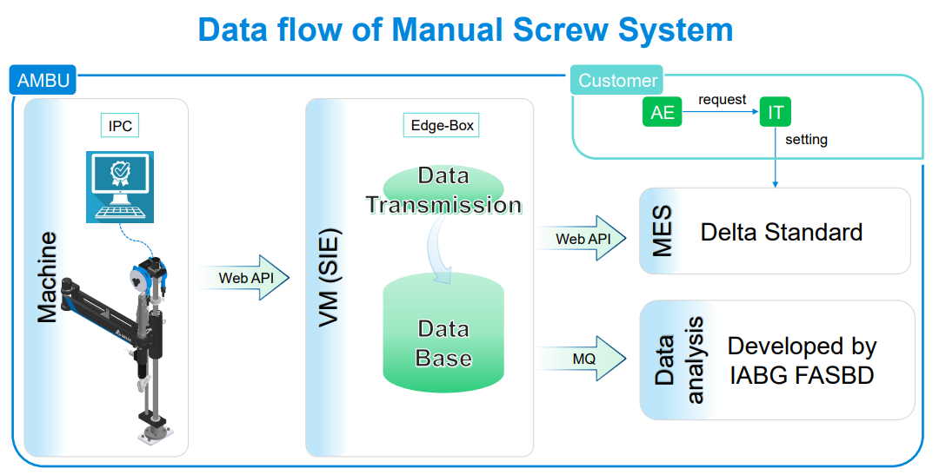

Slide 4
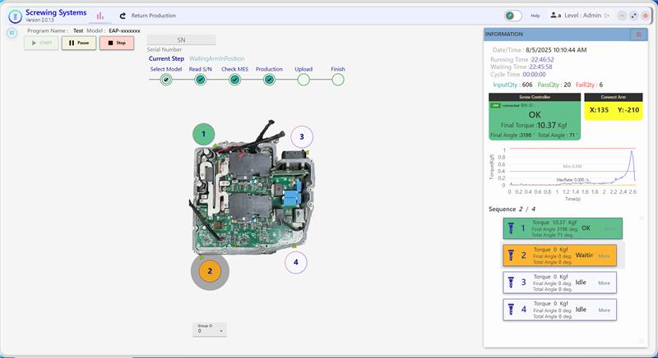
Software of Smart screw System
Realtime & Status bar
Show serial number, current step and status
PQM & MES & DIASSA
Upload PQM, MES, DIASSA
Smart Screw & ARM display
show smart screw connection status and tightening results and show coordinate ARM position
Line Chart
show torque/time, torque rate/ time
Sequence Control
Parameter tightening control and recording tightening results.
Product Navigate
Show points and sequence control follow OI

Slide 5
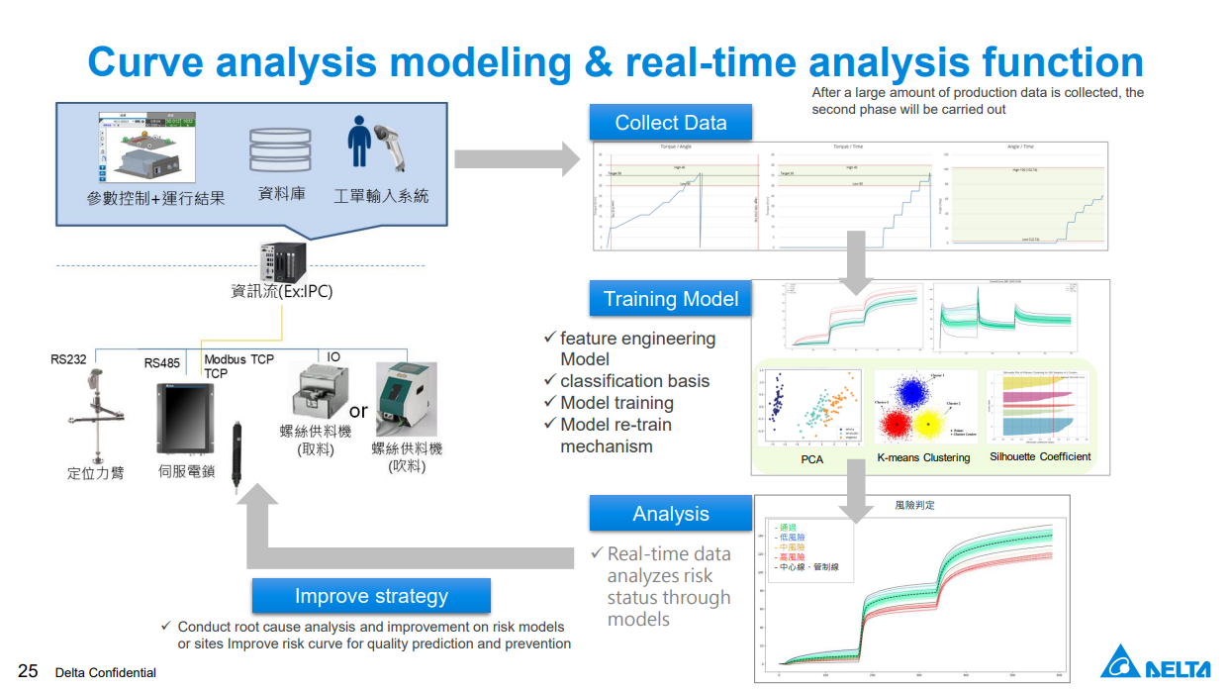

Slide 6
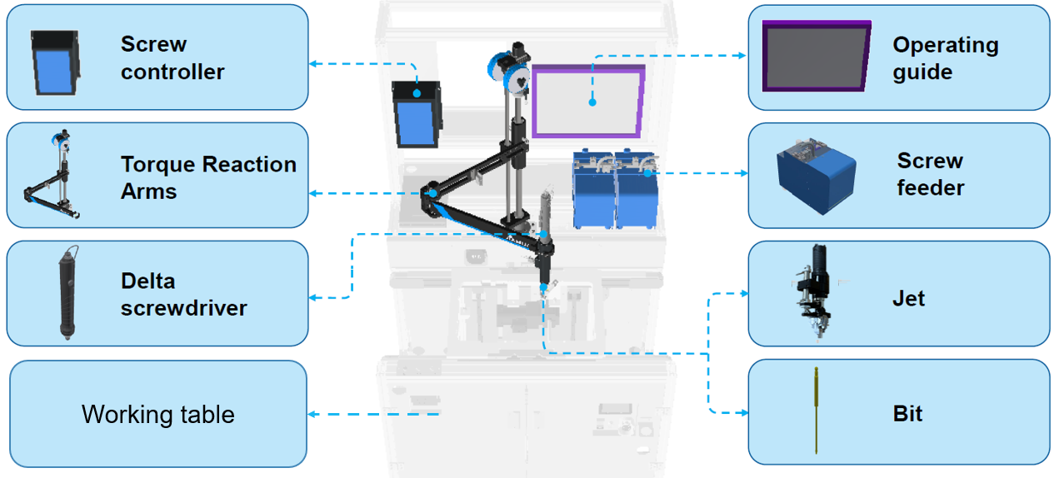
Smart screw structure

Slide 7

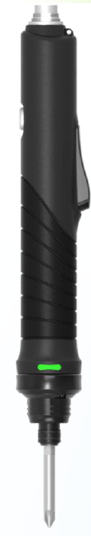

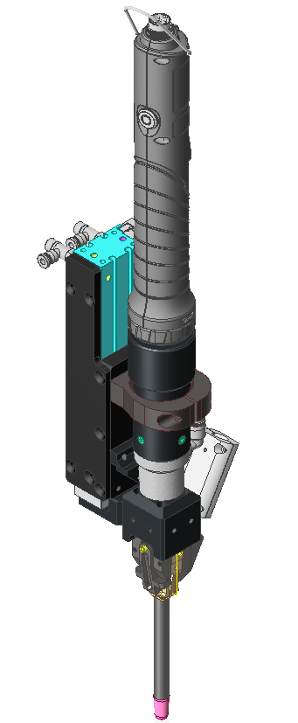
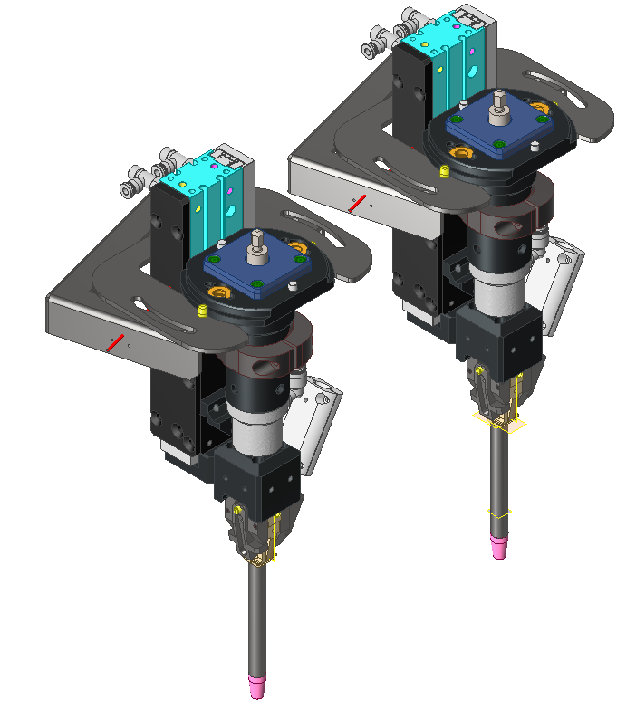
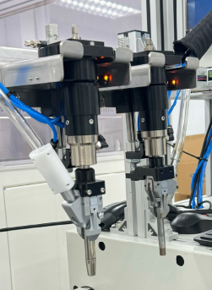
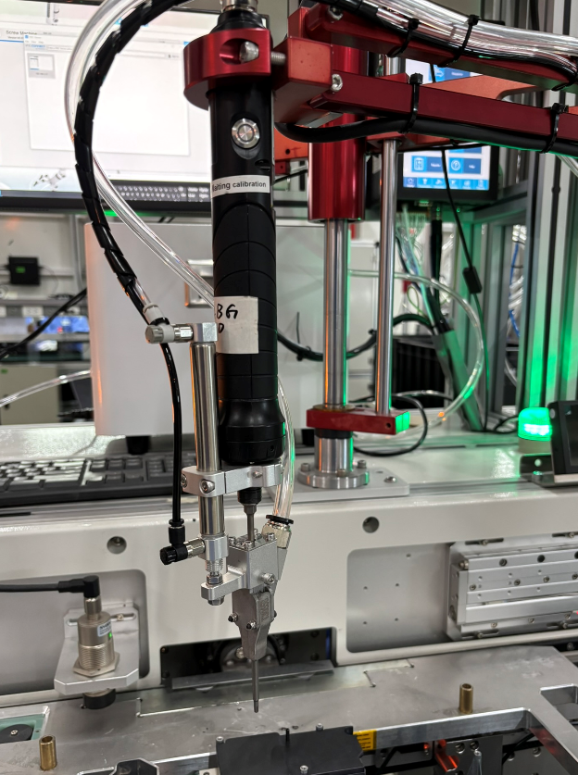
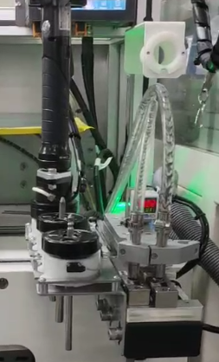
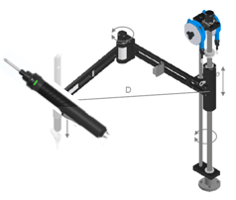
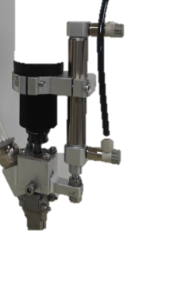
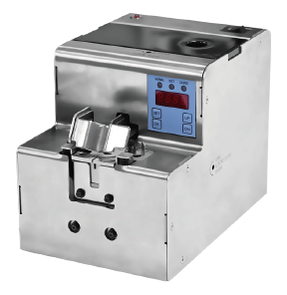
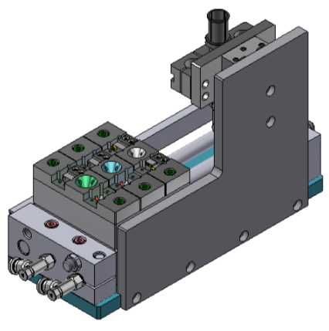
Smart screw module
Type | A | A+ | C | C+ | N | D | D+ | NS
Module
Non-touch screw | YES | YES | YES | YES | YES | YES | YES | YES
Solution function | Direct shoot screw | Direct shoot screw &tool change | Direct shoot screw (magnet) | Direct shoot screw (Magnet Tool change) | Pick screw (magnet) | Pick screw (Vacuum) | Pick screw (Vacuum Tool change) | Pick screw (magnet Top & Front screw)
Delta smart screw system (DIASSA) | YES | YES | YES | YES | YES | YES | YES | YES
Arm sequent control | YES | YES | YES | YES | YES | YES | YES | YES
Multi screw type | 1 | 1-3 | 1 | 1-3 | 1-3 | 1 | 1-3 | 1-3
Function drop detection | YES | YES | NO | NO | NO | YES | YES | NO

Slide 8
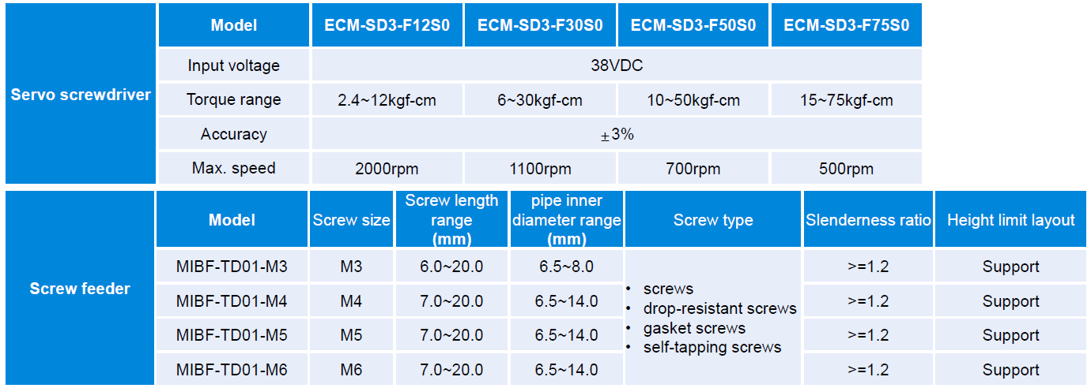
Application specification

Slide 9
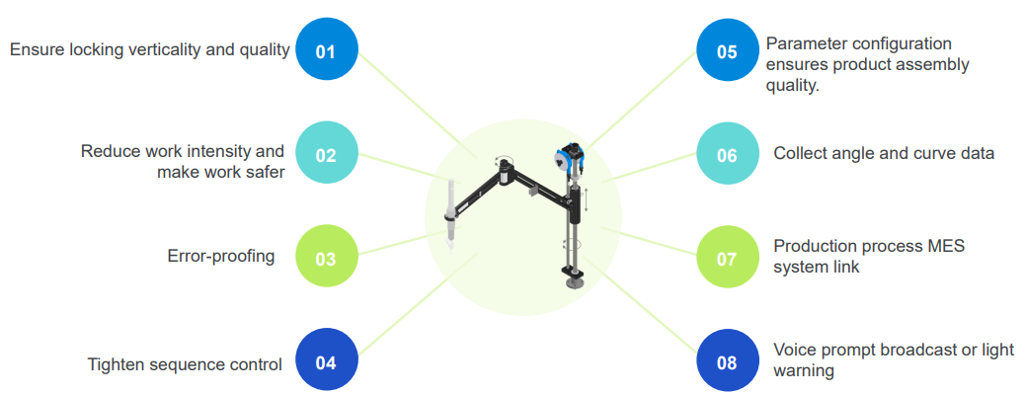
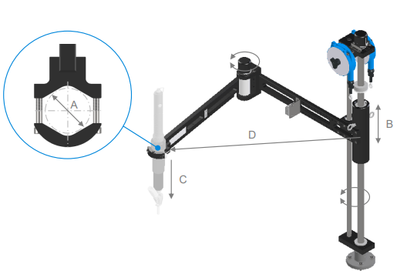
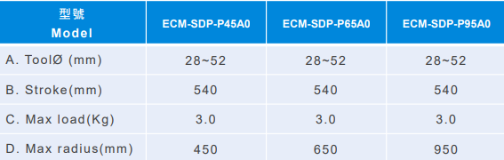
Delta Swing Torque arm dimension
Swing 450
Swing 650
Swing 950

Slide 10
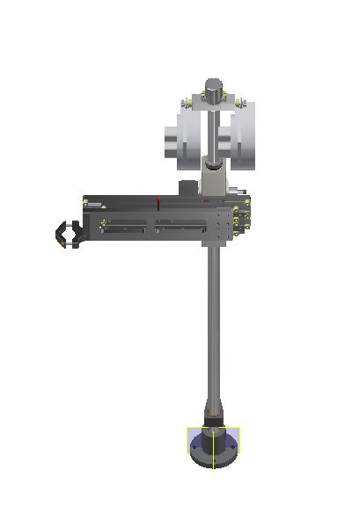
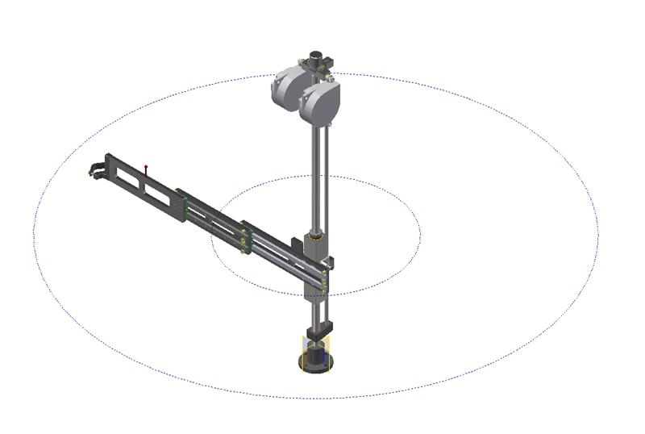
Delta Slide Torque arm dimension
Model | Slide 450 mm | Slide 650 mm | Slide 1000 mm | Slide 1250 mm
Tool Ø (mm) | 28-52 | 28-52 | 28-52 | 28-52
B. Stroke(mm) | 450 | 650 | 1000 | 1250
C. Max load(Kg) | 3.0 | 3.0 | 3.0 | 3.0

Slide 11
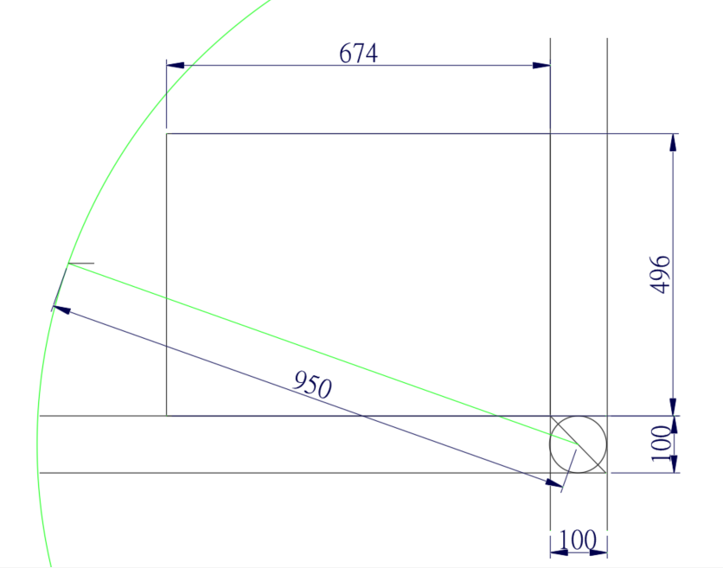
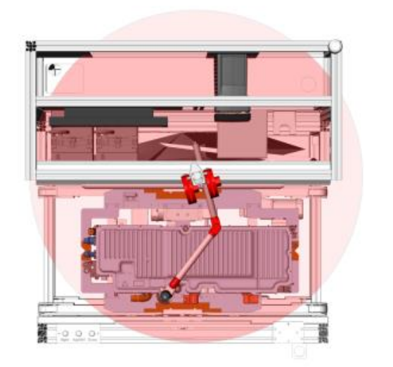
Workspace simulation
Fix on front right of operator
Fix on front inside of operator

Slide 12
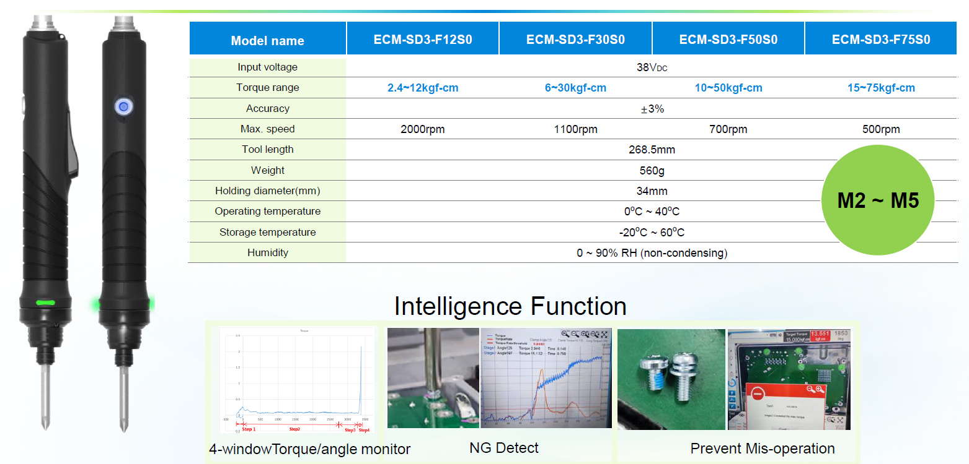
Delta Screwdriver

Slide 13
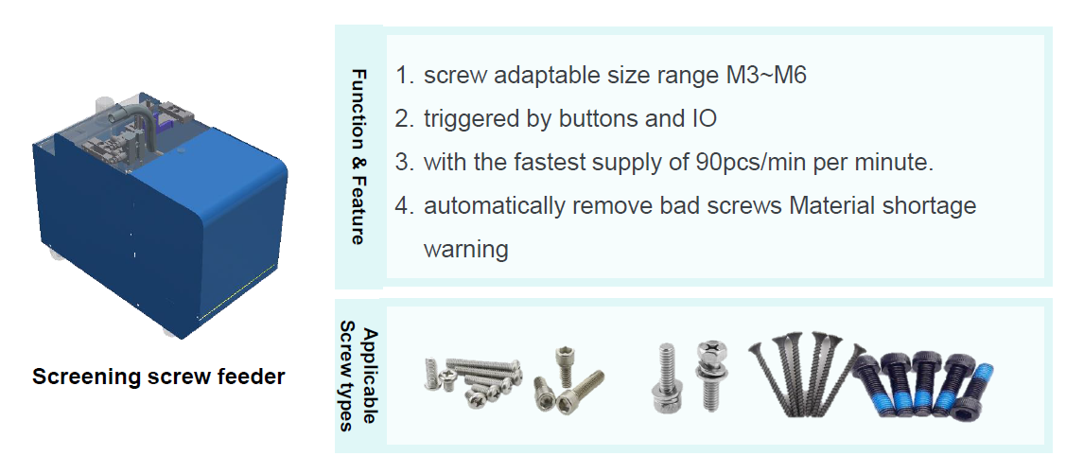
Blow Screw feeder
MRO PN | Model | Description
A00100301914 | AM-H0503002-0000 | Screw feeder tube M3-4
A00100301915 | AM-H0503002-1000 | Screw feeder tube M5-6
A00100302336 | AM-H0503002-2000 | Screw feeder Long lift M3-4
A00100302332 | AM-H0503002-2001 | Screw feeder Long lift M5-6
A00100302331 | AM-H0503002-5000 | Nut feeder Tube shoot

Slide 14
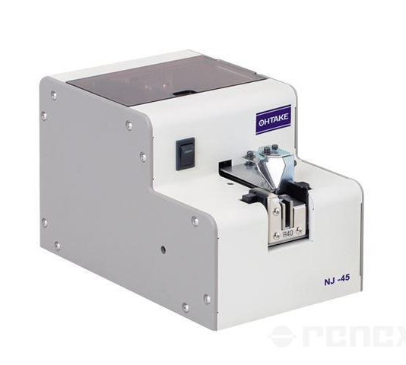
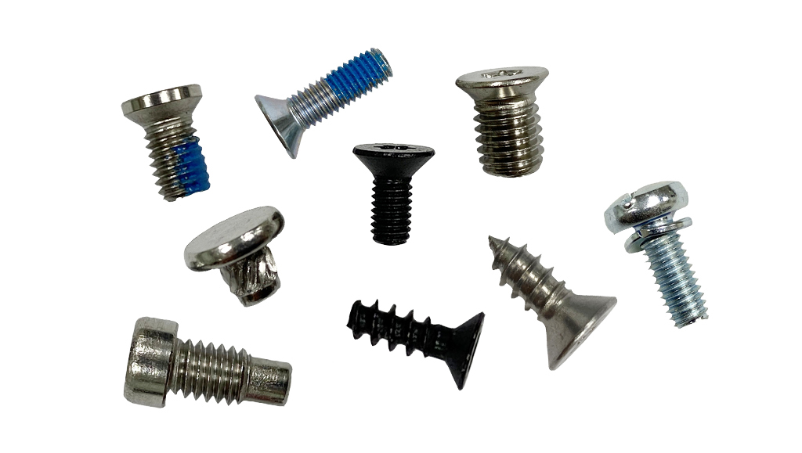
Smart screw feeder
MRO PN | Model | Description
A00100302337 | AM-H0503002-3000 | ASSY SCREW FEEDER PICK&PULL OUT M2-M6
A00100302333 | AM-H0503002-3004 | ASSY SCREW FEEDER PICK&PULL OUT M2-M8
A00100302338 | AM-H0503002-4000 | ASSY SCREW FEEDER SIDE ROTATION M2-M6
A00100302334 | AM-H0503002-4002 | ASSY SCREW FEEDER SIDE ROTATION M2-M6

